Slide 1
DeepSolar
Data Exploration & Analysis
Presented by Alexandra Durec

Slide 2
Agenda
Description of Dataset
Process Overview
Top Correlations
Statistical Analysis of Top Factors
Recommendations

Slide 3

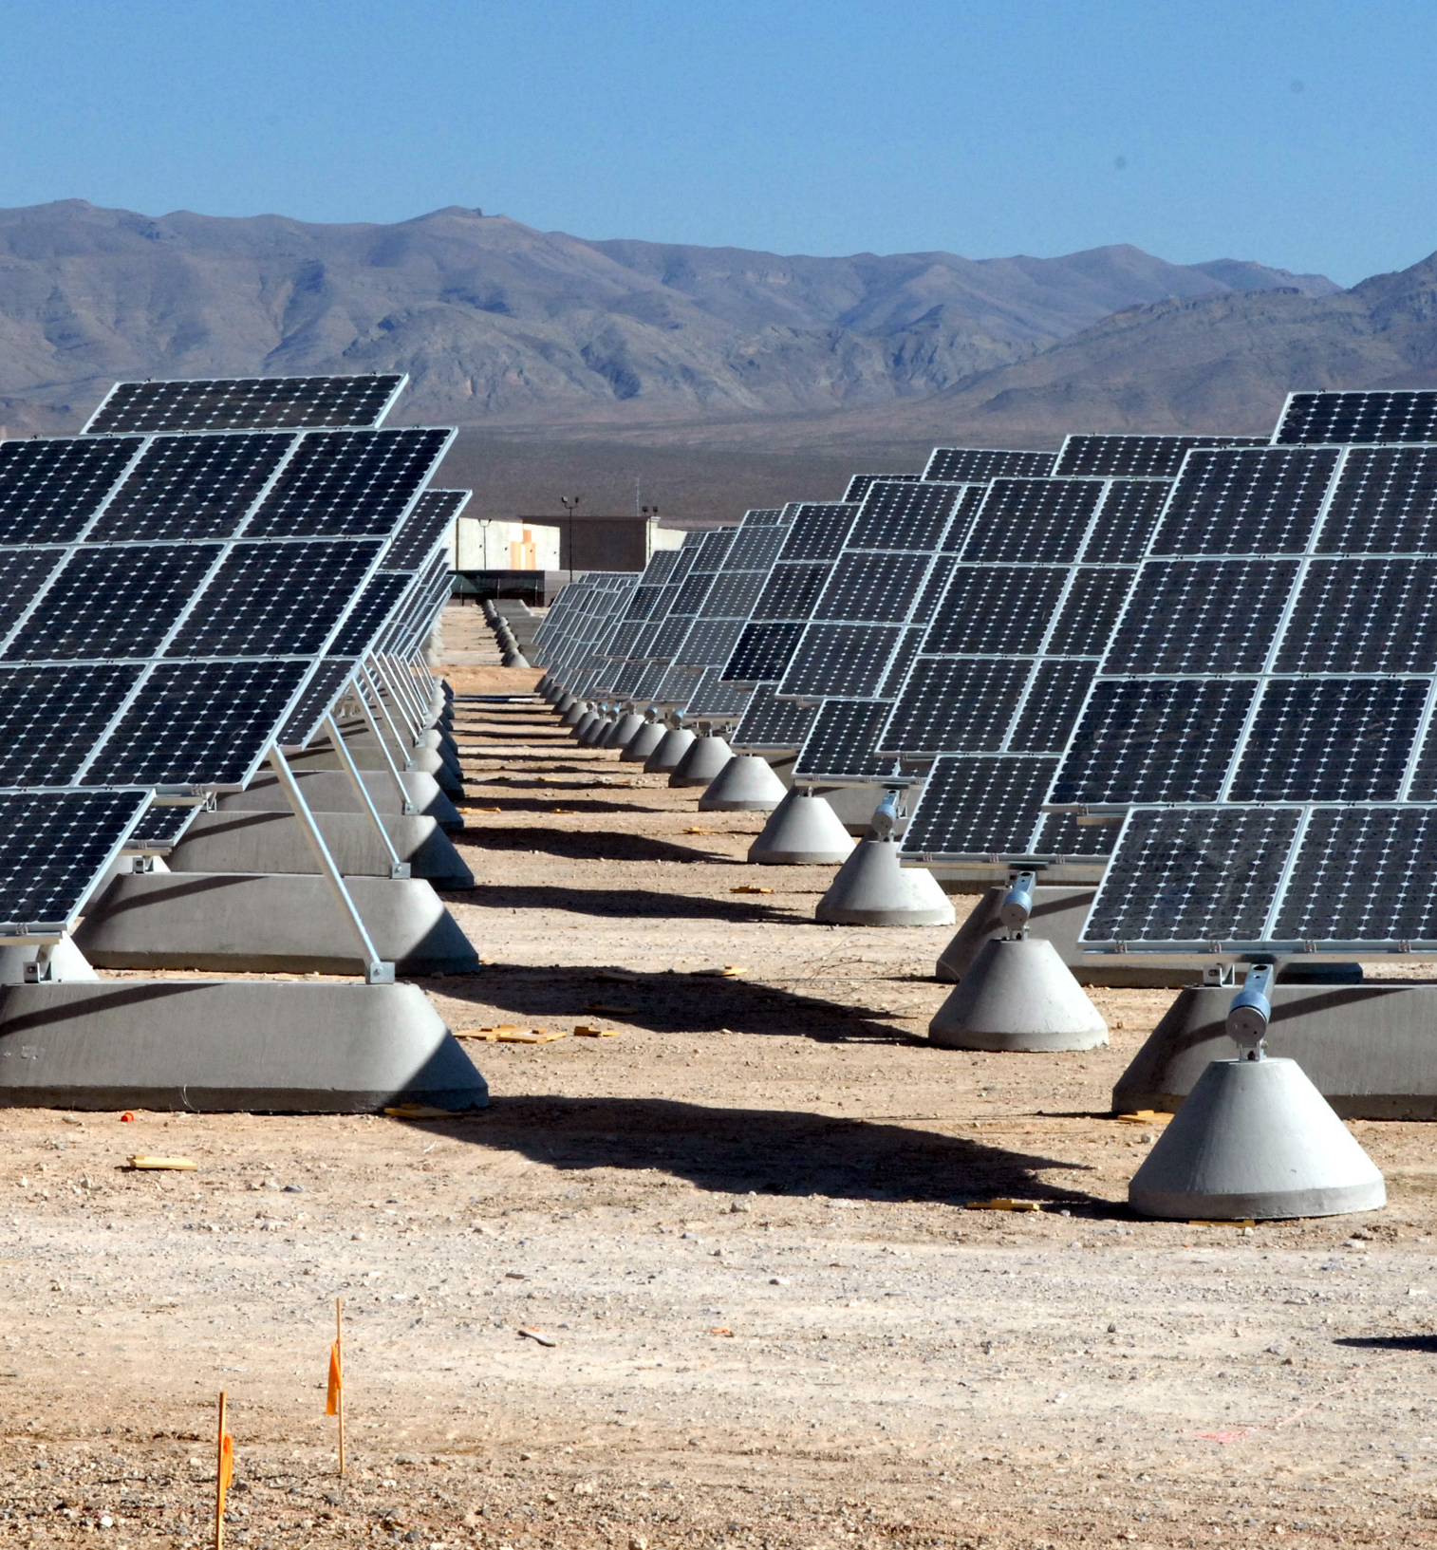
Introduction
The goal of this analysis to find factors that influence the saturation of solar panel systems by state. The focus state is New Mexico and the conclusions and recommendations are areas of potential opportunities for Solar Companies in the state of New Mexico.
March 2021
DeepSolar Data Exploration & Analysis

Slide 4
DeepSolar Dataset
Description and Factors of Interest
March 2021
DeepSolar Data Exploration & Analysis
4

Slide 5
Description and Factors of Interest
Description
Factors of Interest
DeepSolar is a deep learning framework that analyzes satellite imagery to identify the GPS locations and sizes of solar panels. Leveraging its high accuracy and scalability, DeepSolar constructed a comprehensive high-fidelity solar deployment database for the contiguous U.S.
The DeepSolar database includes location, size, and type (residential/non-residential) information for each recorded solar power system.
Although the DeepSolar dataset contains very localized information the focus for this project will be on analyzing state-level data.
The dataset does provide a ‘Number of Solar Systems Per Household’ factor but, as will described later in detail, this is not the best use of the data for state-level analysis
The DeepSolar Project Homepage is
http://web.stanford.edu/group/deepsolar/home

Slide 6
Process Overview
Analysis Process
March 2021
DeepSolar Data Exploration & Analysis
6

Slide 7
Analysis Process
Prep Data
Find Top Correlations
Statistical Analysis
While investigating the ‘Number of Solar Systems per Household’ field many INF and NaN entries were found.
In order to have a more accurate analysis of state level data a new field, ‘Solar Systems per Capita’ was created.
‘Solar Systems per Capita’ is calculated by the sum of each state's 'solar_system_count' / sum of each state's 'population’.
Using the Pearson correlation coefficient the ‘Number of Solar Systems per Capita’ factor will be compared to all other fields in the dataset.
Moderate to high correlations will be analyzed further.
Correlation coefficients over 0.5 are considered moderate.
For each top correlation the null hypothesis, that there is no difference between the population means of higher solar system saturation states and New Mexico as well as lower solar system saturation states, will be tested.
For each top correlation where the null hypothesis is rejected the confidence interval will be calculated.

Slide 8
Top Correlations
Factors found to be Moderately to Highly Correlated
March 2021
DeepSolar Data Exploration & Analysis
8

Slide 9
Top 20 Correlations with ‘Solar Systems per Capita’
solar_system_per_capita | 1
incentive_count_residential | 0.811684
incentive_count_nonresidential | 0.793869
daily_solar_radiation | 0.735794
electricity_price_industrial | 0.712573
feedin_tariff | 0.712464
electricity_price_commercial | 0.630161
rebate | 0.624075
electricity_price_overall | 0.607066
solar_panel_area_divided_by_area | 0.596951
avg_electricity_retail_rate | 0.581674
incentive_residential_state_level | 0.578427
incentive_nonresidential_state_level | 0.537043
heating_design_temperature | 0.510073
solar_system_count | 0.497833
solar_system_count_residential | 0.496559
tile_count_residential | 0.491867
total_panel_area_residential | 0.47769
earth_temperature | 0.474125
electricity_price_residential | 0.464109

Slide 10
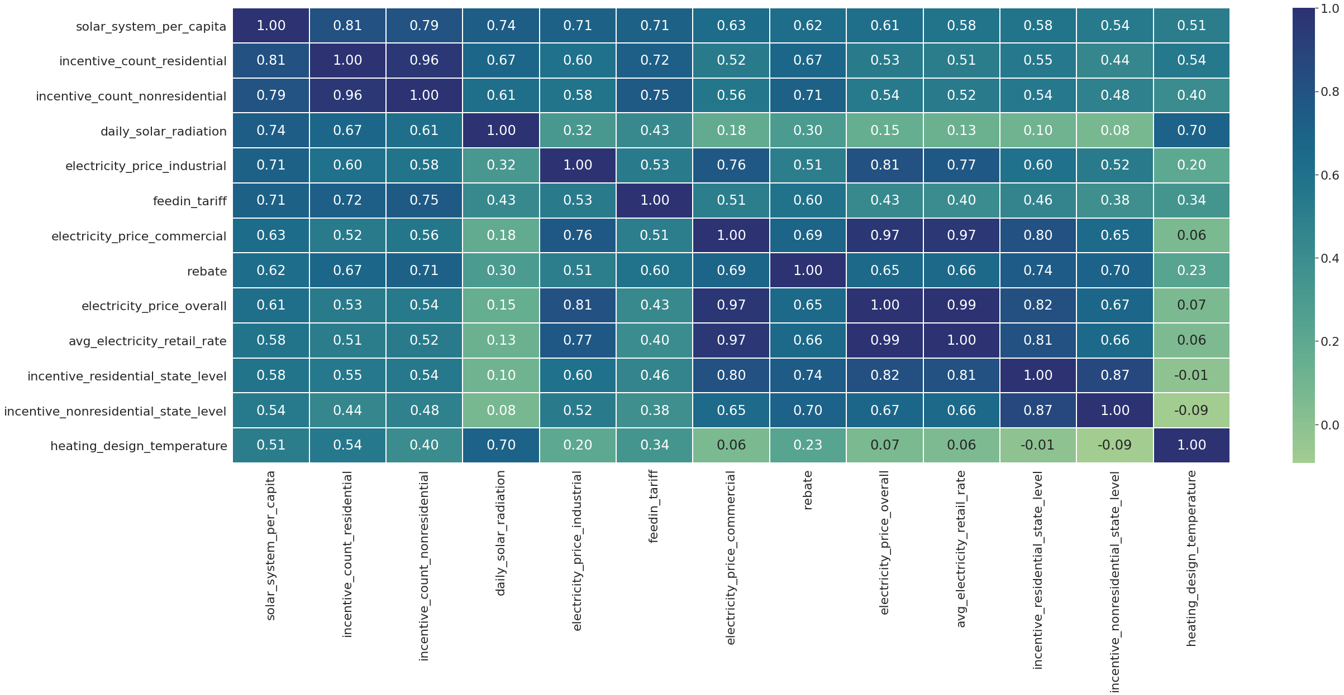
Correlation heatMap

Slide 11
Statistical Analysis
Top Factors are Statistically Analyzed
March 2021
DeepSolar Data Exploration & Analysis
11

Slide 12
Null Hypothesis and Confidence Interval
During statistical analysis the null hypothesis was rejected for all factors, showing that there is a statistical difference between the population means of Lower and Higher Saturation States vs New Mexico.
The absolute values for the t-stats are between 2.9 and 77.0
The p-values are between 1.78E-239 and 0.003
The t-stat, p-value and confidence interval data is available at the end of this presentation in the appendix.

Slide 13
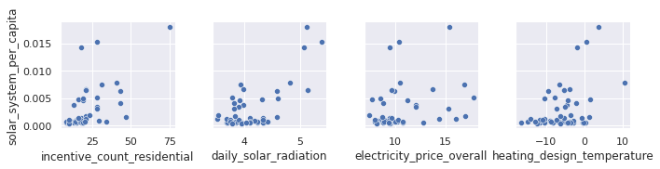
Solar Systems Per Capita
Distribution Scatter Plot Preview of Factors

Slide 14
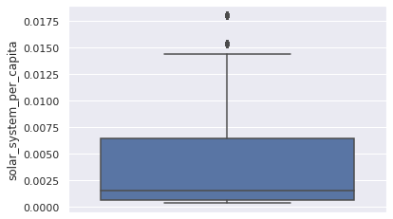
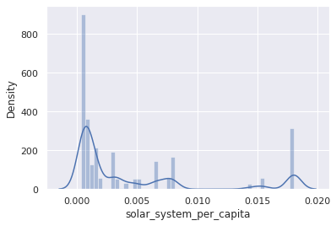
Solar Systems Per Capita
Distribution Visualizations with Box Plot and Histogram

Slide 15
Solar Systems Per Capita Conclusions
As can be seen by the distribution visualizations most states have low saturation with a few outliers.
As would be expected New Mexico is only slightly less saturated than states with higher saturation and slightly more saturated than states with lower saturation.

Slide 16
Incentives
All Incentive factors, rebate, and feed-in tariff all fall into the general category of incentives. These can be on the state, county or city level and provide some sort of monetary benefit to consumers for installing or using solar panel systems.
A feed-in tariff pays the owner of the solar panel system for surplus energy they produce and send on to the National Grid.
Because these factors are so closely related in-depth analysis will only be shown for the factor with the highest correlation, Incentive Residential Count.
Visualizations are available at the end of this presentation in the appendix.

Slide 17
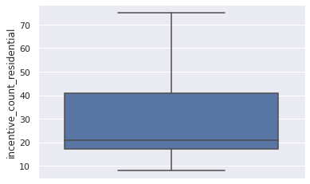
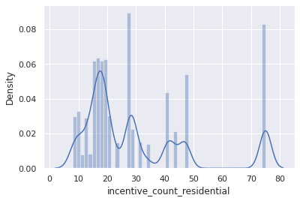
Incentive Residential Count
Distribution Visualizations with Box Plot and Histogram

Slide 18
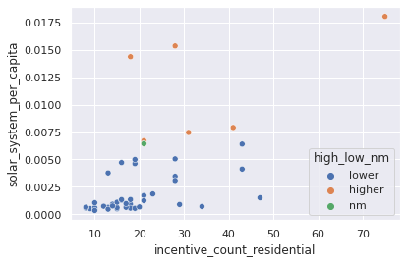
Incentive Residential Count
Correlation Visualized with Scatter Plot

Slide 19
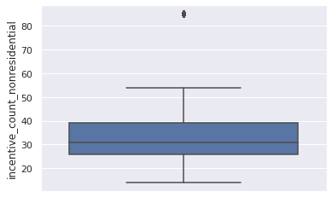
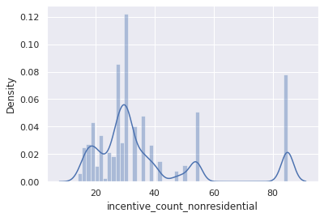
Incentive Nonresidential Count
Distribution Visualizations with Box Plot and Histogram

Slide 20
Incentives, Rebate, Feed-in Tariff Conclusion
As can be seen by the distribution visualizations most states have low incentives with a few outliers. The exceptions are Incentive Residential State Level and Incentive Nonresidential State Level which have a more even distribution.
In general New Mexico has less incentives than the states with higher solar system saturation.

Slide 21
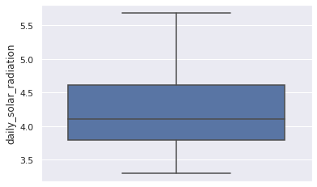
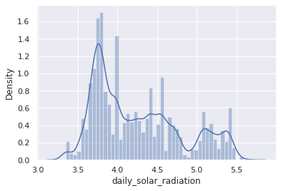
Daily Solar Radiation
Distribution Visualizations with Box Plot and Histogram

Slide 22
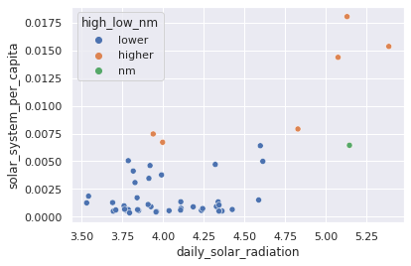
Daily Solar Radiation
Correlation Visualized with Scatter Plot

Slide 23
Daily Solar Radiation Conclusion
As can be seen by the distribution visualizations most states have fairly low Daily Solar Radiation.
New Mexico has lower Daily Solar Radiation than states with higher solar system saturation and slightly higher than states with lower solar system saturation.

Slide 24
Industrial, Commercial, Average Retail Rate of Electricity
Because these factors are so closely related in-depth analysis will only be shown for Overall Electricity Price.
Visualizations are provided on next slides for reference at the end of this presentation in the appendix.

Slide 25
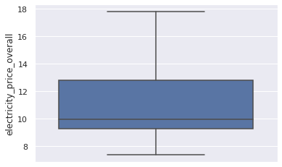
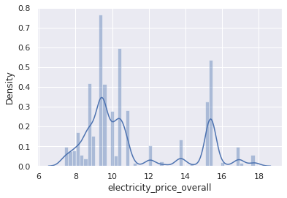
Electricity Price Overall
Distribution Visualizations with Box Plot and Histogram

Slide 26
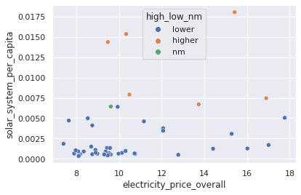
Electricity Price Overall
Correlation Visualized with Scatter Plot

Slide 27
Electricity Price Overall Conclusion
As can be seen by the distribution visualizations most states have low Overall Electricity Price but there is a split distribution so there are also a fairly high number of states with a higher electricity price.
New Mexico has lower Overall Electricity Price than both states with higher and lower solar system saturation but there is a bigger difference with states that have a higher solar system saturation.

Slide 28
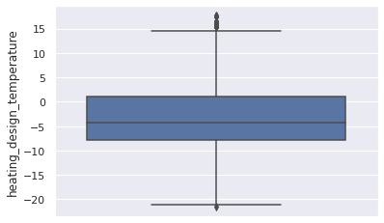
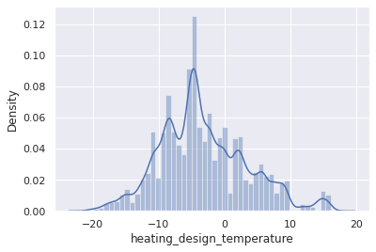
Heating Design Temperature
Distribution Visualizations with Box Plot and Histogram

Slide 29
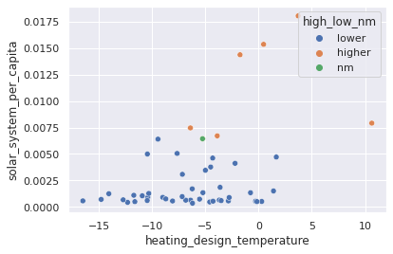
Heating Design Temperature
Correlation Visualized with Scatter Plot

Slide 30
Heating Design Temperature Conclusion
Heating Design Temperature is an Energy Star Certification factor.
EPA recommends 1% cooling season design temperature and 99% heating season design temperature for the weather location that is geographically closest to the home to be certified.
As can be seen by the distribution visualizations the Heating Design Temperature is evenly distributed.
New Mexico has lower Heating Design Temperature than both states with higher and lower solar system saturation but there is a bigger difference with states that have a higher solar system saturation.

Slide 31
Conclusion and Recommendations
March 2021
DeepSolar Data Exploration & Analysis
31

Slide 32
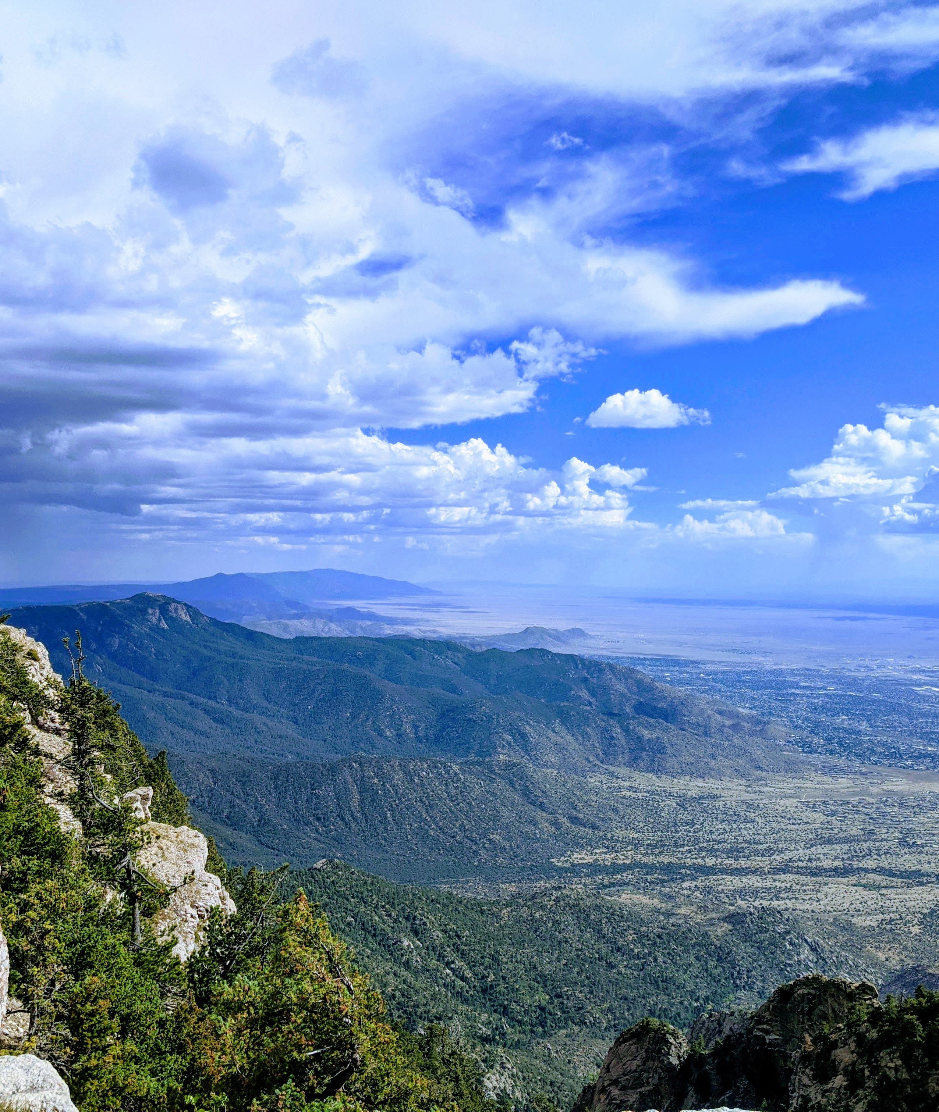

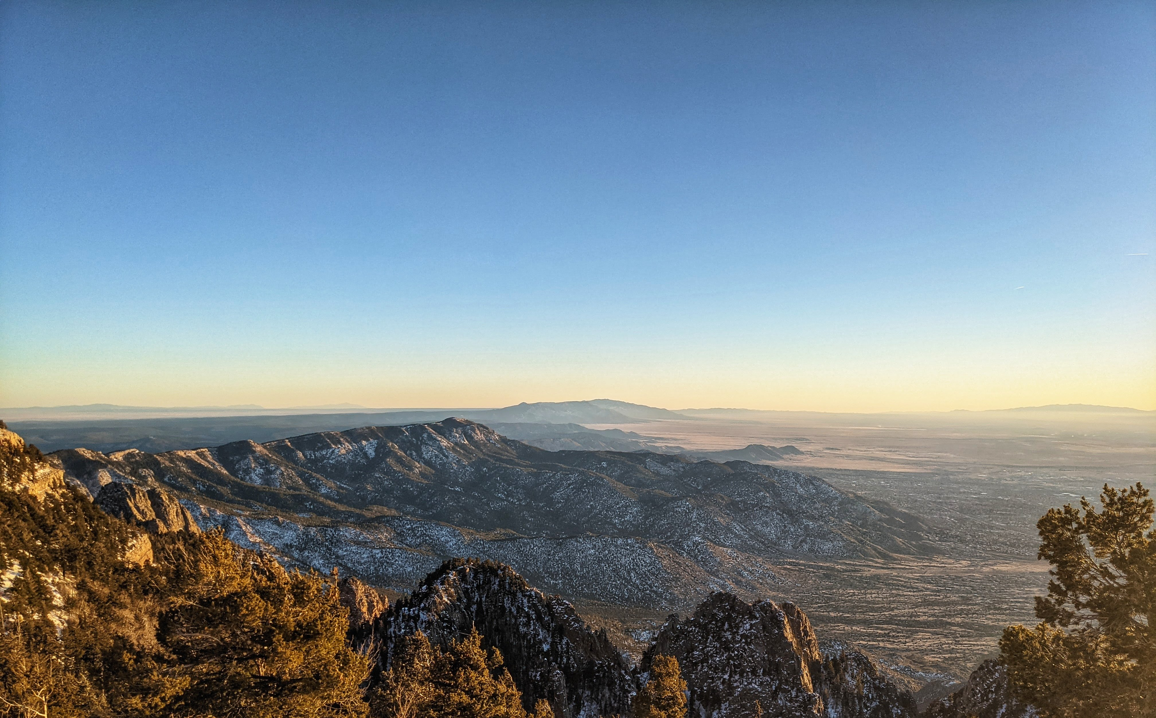
Conclusion
Given the conclusions drawn from analysis it is recommended that New Mexico Solar Companies consider factors that are within the realm of human control.
The Overall Electricity Prices are not controllable by a Solar Company but it is trending upwards in New Mexico. This presents a potential area of opportunity in the coming years for Solar Companies.
An increase in incentives in any form would also benefit Solar Companies and I would recommend they push for that in the political realm by supporting candidates that are in favor of the New Mexico’s Energy Transition Act. In 2019 the legislature and Governor Michelle Lujan Grisham enacted the Energy Transition Act, this legislation commits New Mexico to 50% carbon-free energy by 2030 and 100% carbon free energy by 2045.
See links for more information:
https://cvnm.org/a-bold-vision-for-new-mexico/
https://errorsofenchantment.com/new-report-new-mexico-residential-electricity-rates-rose-9-2-over-past-year/
March 2021
DeepSolar Data Exploration & Analysis
32

Slide 33



Thank you
Alexandra Durec
alexandradurec@gmail.com
alex-durec on LinkedIn and GitHub
DeepSolar Analysis Colab Notebook

Slide 34
Appendix
Contents:
Statistical Analysis Details
Incentive Residential State Level Visualizations
Incentive Nonresidential State Level Visualizations
Feed-in Tariff Visualizations
Rebate Visualizations
Industrial, Commercial, Average Retail Rate Visualizations

Slide 35
Statistical Analysis Detail

Slide 36
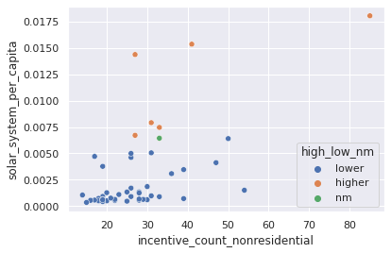
Incentive Nonresidential Count
Correlation Visualized with Scatter Plot

Slide 37
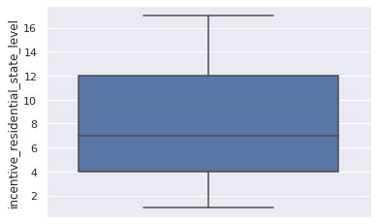
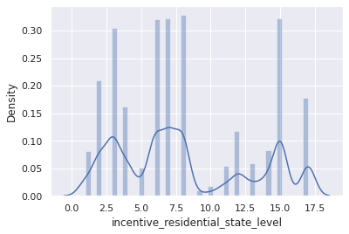
Incentive Residential State Level
Distribution Visualizations with Box Plot and Histogram

Slide 38
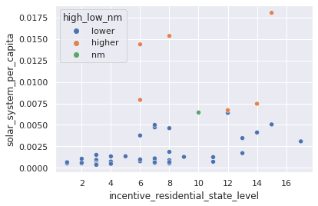
Incentive Residential State Level
Correlation Visualized with Scatter Plot

Slide 39
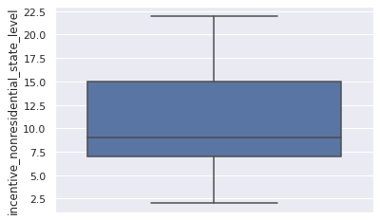
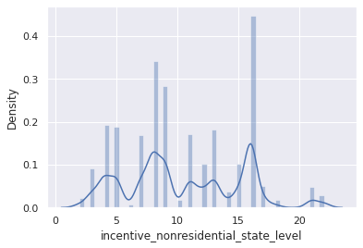
Incentive Nonresidential State Level
Distribution Visualizations with Box Plot and Histogram

Slide 40
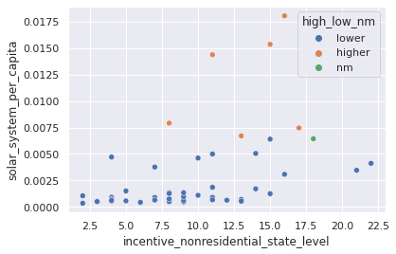
Incentive Nonresidential State Level
Correlation Visualized with Scatter Plot

Slide 41
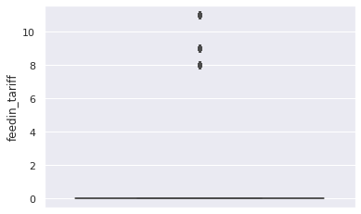
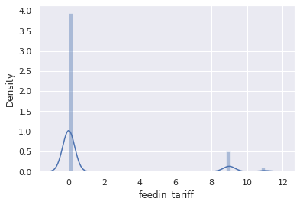
Feed-in Tariff
Distribution Visualizations with Box Plot and Histogram

Slide 42
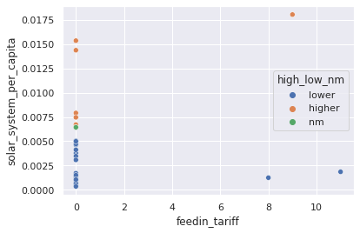
Feed-in Tariff
Correlation Visualized with Scatter Plot

Slide 43
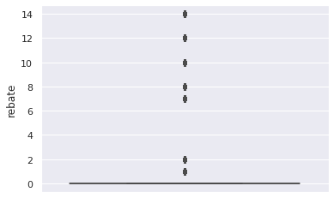
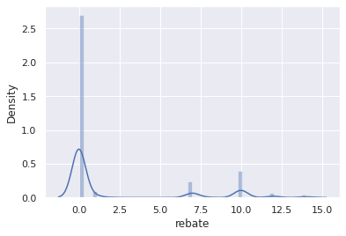
Rebate
Distribution Visualizations with Box Plot and Histogram

Slide 44
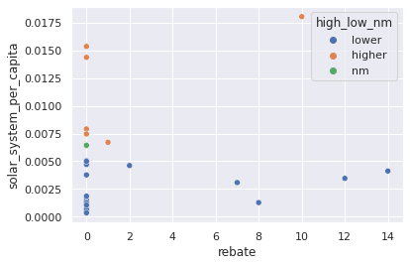
Rebate
Correlation Visualized with Scatter Plot

Slide 45
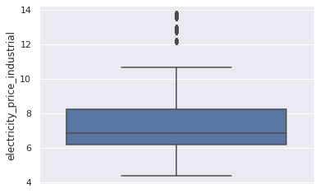
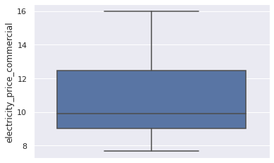
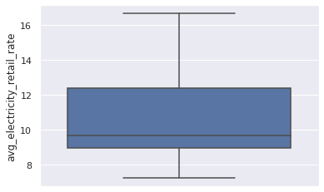
Industrial, Commercial, Average Retail Rate
Visualize Distribution with Box Plots

Slide 46
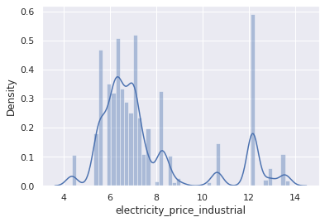
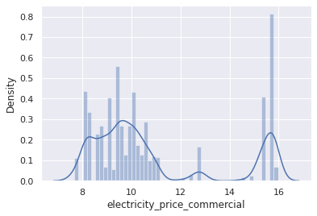
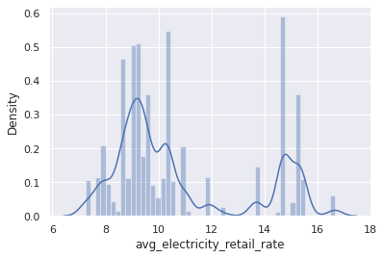
Industrial, Commercial, Average Retail Rate
Visualize Distribution with Histograms

Slide 47
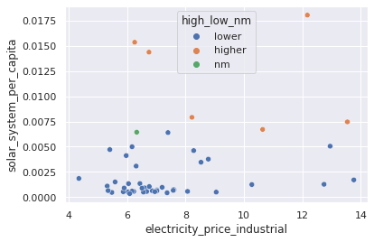
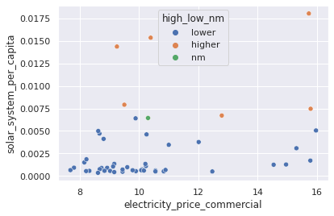
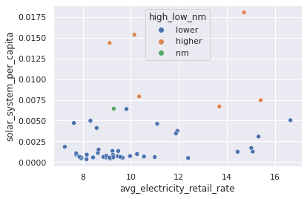
Industrial, Commercial, Average Retail Rate
Correlation Visualized with Scatter Plot

